Slide 1


ACT® Aspire®
Summative Reports
Notes:
Welcome to the ACT Aspire Summative Reports training. This training provides information about the ACT® Aspire® Summative Reports, including what data is provided, where to locate the reports, and additional resources available.

Slide 2





Agenda
ACT Aspire Summative Reports Overview
Downloading Summative Reports in PearsonAccess^{next}
ACT Aspire OnDemand Reports
ACT Aspire Summative Report Resources
Notes:
During this training, we’ll review the following topics:
ACT Aspire Summative Reports Overview
Downloading Summative Reports in PearsonAccess^{next}
ACT Aspire OnDemand Reports
ACT Aspire Summative Report Resources

Slide 3
ACT® Aspire® Summative Reports Overview
Notes:
Our first topic details the summative reports available in PearsonAccess^{next}.

Slide 4
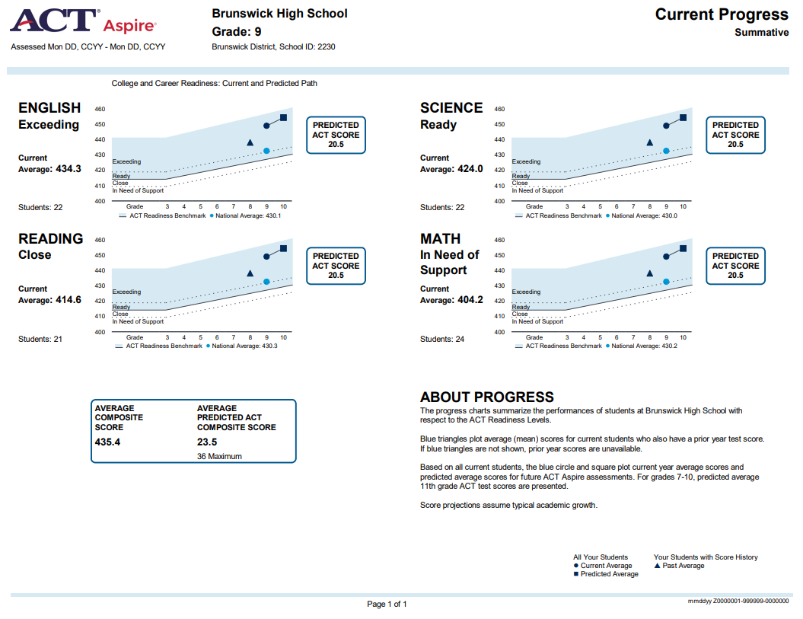
Summative Reports: Current Progress
Report Description:
Current year average scale scores, average Composite scores, predicted future performance, and predicted ACT score ranges
Available at the district and school level
Notes:
The Current Progress Report provides an overall view of school performance and students predicted path in all assessed subjects except writing. An ACT Aspire average Composite score and predicted average ACT Composite score are shown on the report. Predicted average ACT subject scores are also given for each subject test.

Slide 5
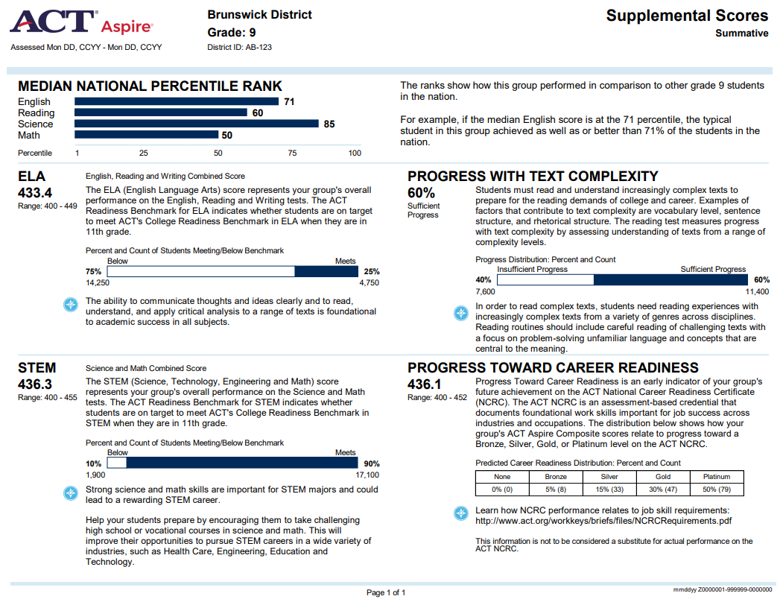
Summative Reports: Supplemental Scores
Report Description:
National Percentile Ranks, ELA, STEM, Progress with Text Complexity, and Progress Toward Career Readiness
Available at the district and school level
Notes:
The Supplemental Scores Report summarizes additional measures of performance, including National Percentile Ranks, ELA, STEM, Progress with Text Complexity, and Progress Toward Career Readiness.

Slide 6
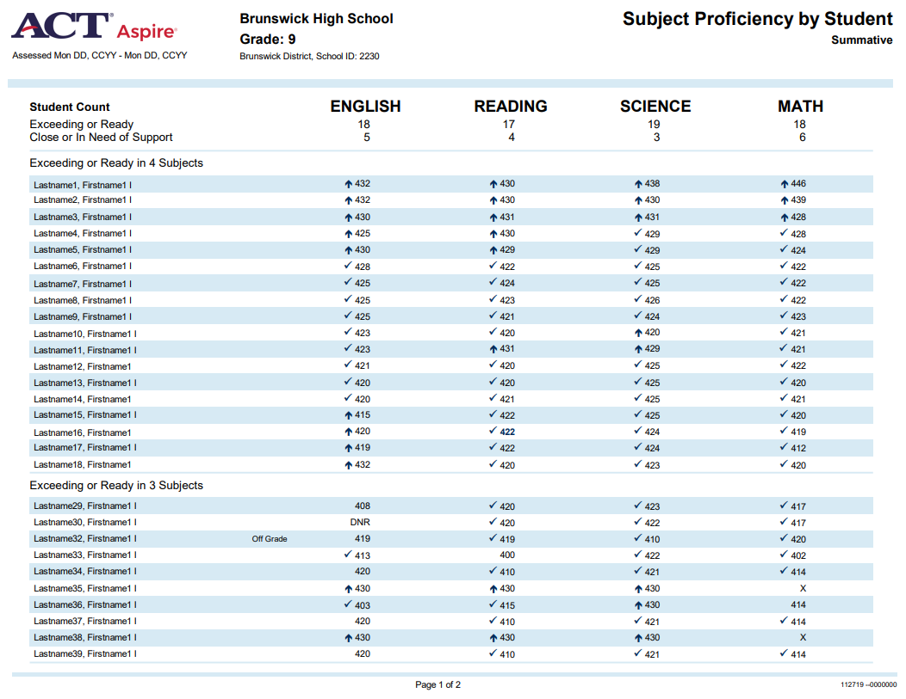
Summative Reports: Subject Proficiency by Student
Report Description:
Summary of subject performance for each student, measured by ACT readiness levels
Available at the school level
Notes:
The Subject Proficiency by Student report indicates the number of students in the school who are at the Exceeding or Ready level and the Close or In Need of Support level. It also provides a roster of students, indicating the test score for each subject except writing.

Slide 7
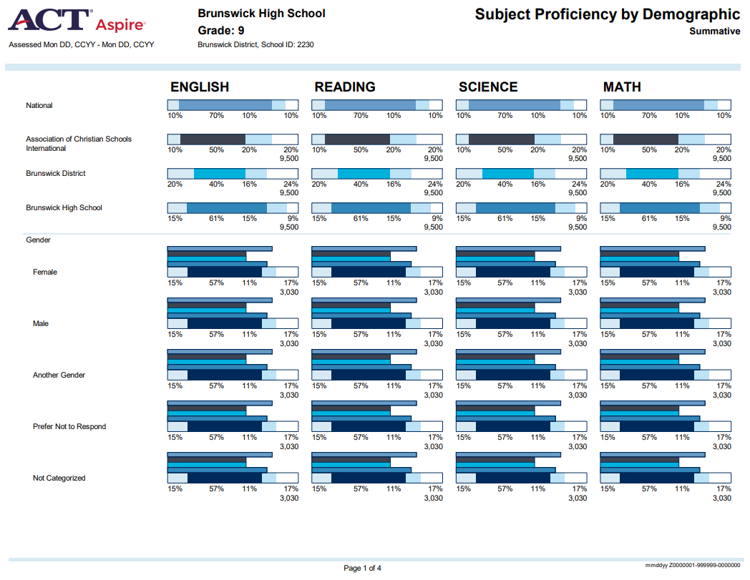
Summative Reports: Subject Proficiency by Demographic
Report Description:
Summary of subject performance by demographic group, measured by ACT readiness levels
Available at the district and school level
Notes:
The Subject Proficiency by Demographic Report summarizes students’ performance by demographic group in all assessed subjects except writing. It also provides the percentage of students at the school who performed in each readiness level: Exceeding, Ready, Close, and In Need of Support.

Slide 8
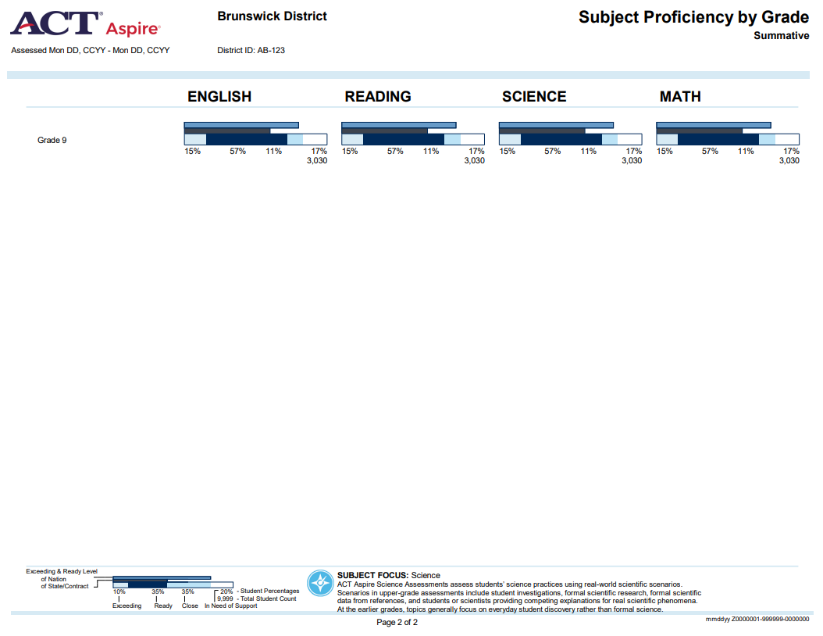
Summative Reports: Subject Proficiency by Grade
Report Description:
ACT readiness level distribution by subject and grade
Available at the district and school level
Notes:
The Subject Proficiency by Grade report provides ACT readiness level distribution by subject and grade.

Slide 9
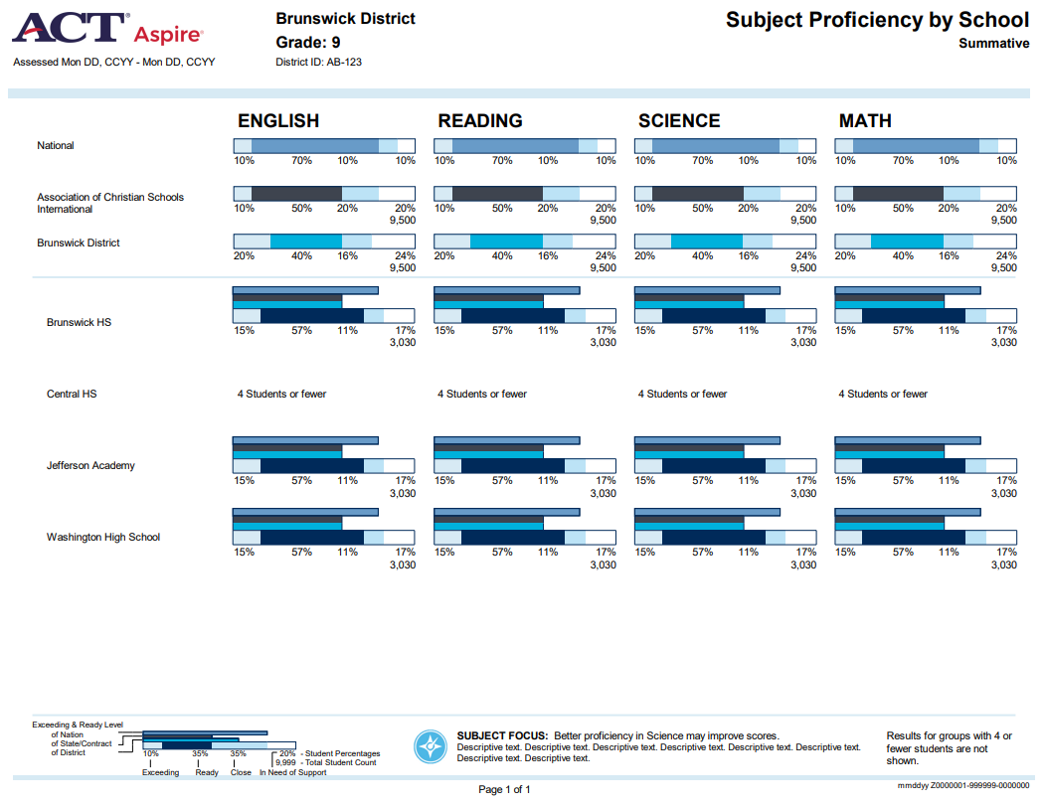
Summative Reports: Subject Proficiency by School
Report Description:
ACT readiness level distribution by subject and school
Available at the district level
Notes:
The Subject Proficiency by School report provides ACT readiness level distribution by subject and school.

Slide 10
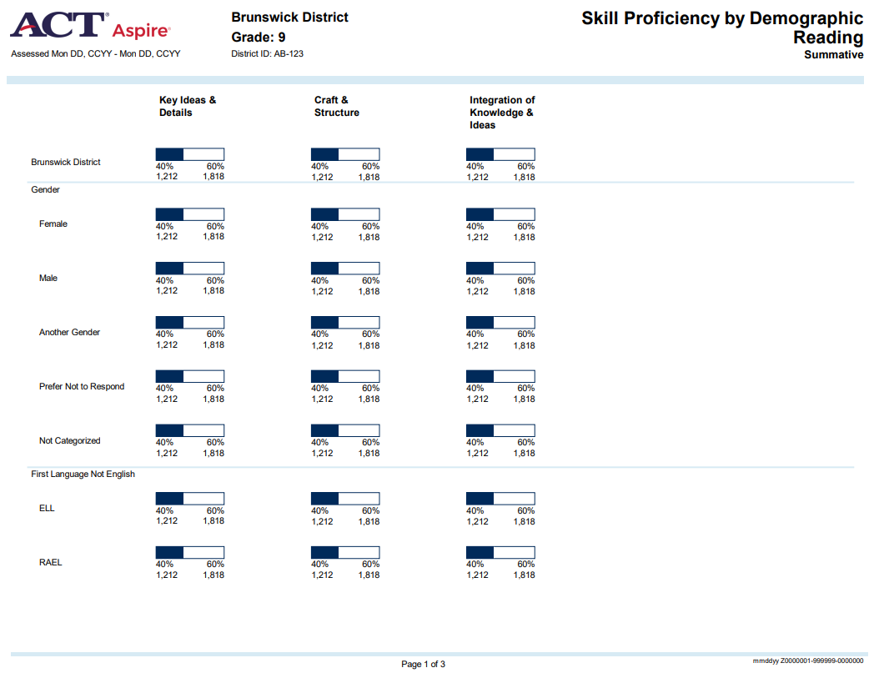
Summative Reports: Skill Proficiency by Demographic
Report Description:
ACT readiness level distributions by demographic
Available at the school and district level
Notes:
The Skill Proficiency by Demographic report is organized by demographics and indicates whether or not each demographic is within or below the ACT Readiness Range in each reporting category for that subject.

Slide 11
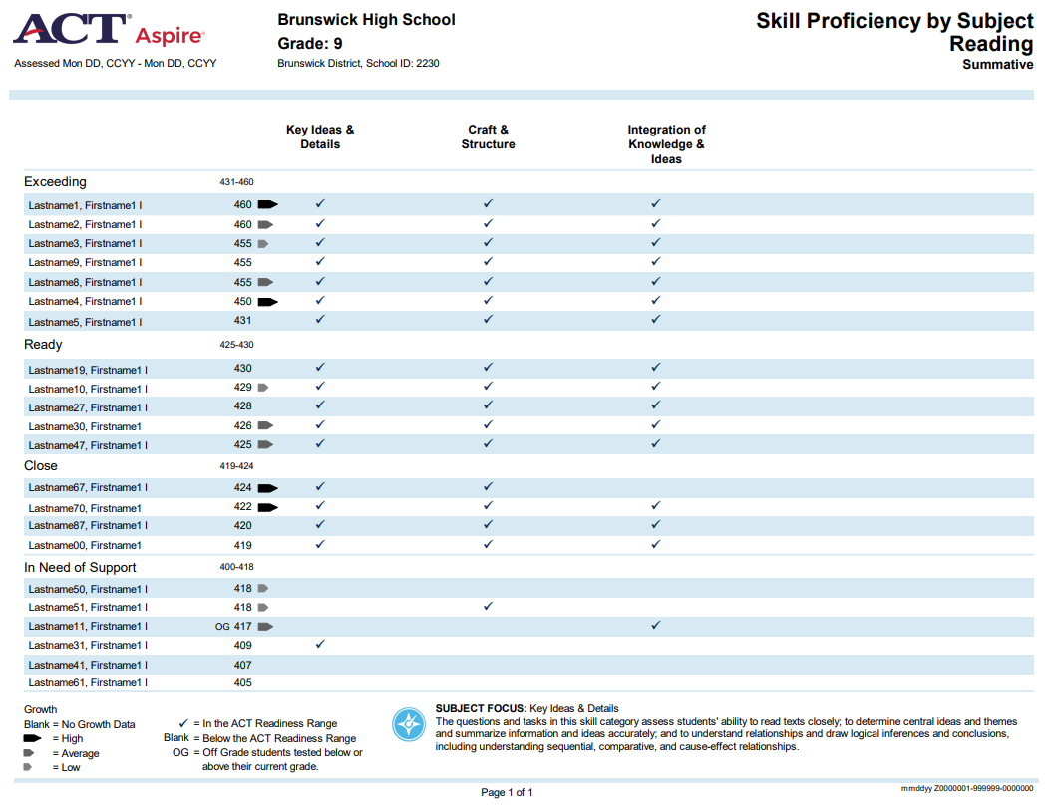
Summative Reports: Skill Proficiency by subject
Report Description:
Scale and skill score summary by subject
Available at the school level
Notes:
The Skill Proficiency by Subject report provides a roster of students, organized by readiness level, along with their subject score. The report also indicates whether or not each student is within or below the ACT Readiness Range in each reporting category for that subject.

Slide 12
Summative Reports: Skill Proficiency by school
Report Description:
Scale and skill score summary by school and subject
Available at the district level
Notes:
The Skill Proficiency by School report provides scale and skill score summary by school and subject.

Slide 13
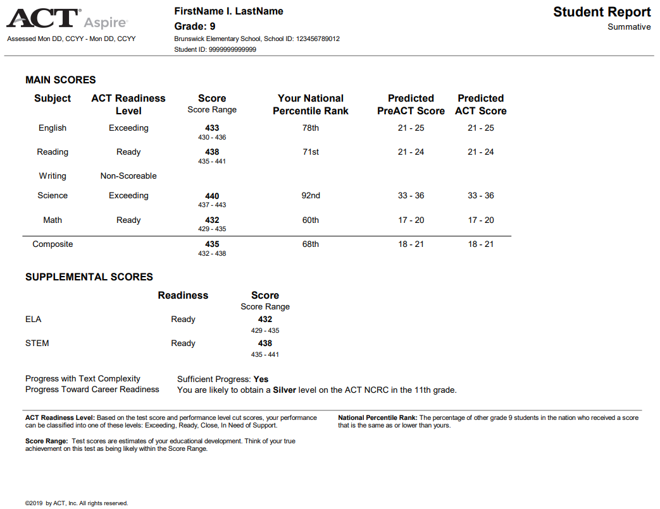
Summative Reports: individual student report (1 page)
Report Description:
All student scores, including reporting category performance and readiness
Available at the school level
Notes:
The one-page Individual Student Report is a print-friendly version of the student report that provides all student scores, including reporting category performance and readiness. National Percentile Rank, Predicted ACT Score, ELA score, STEM score, Progress with Text Complexity, and Progress Toward Career Readiness Indicator are also included.

Slide 14
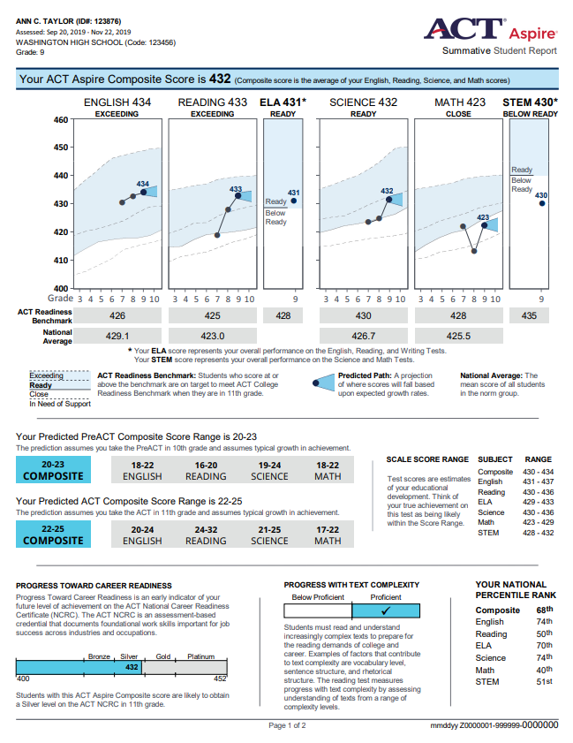
Summative Reports: individual student report (2 page)
Report Description:
All student scores, including reporting category performance and readiness
Available at the school level
Notes:
The two-page Individual Student Report includes all student scores, including reporting category performance and readiness. This report includes graphic representations of the results along with improvement ideas for students.

Slide 15
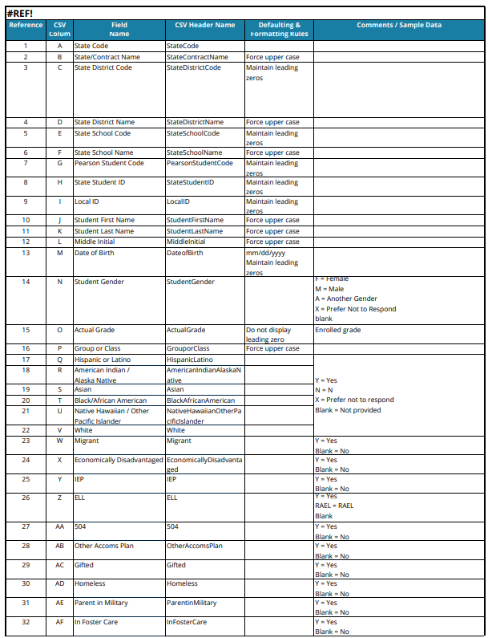
student Performance file (SPF)
Description:
All student scores, including Composite National Percentile Rank, ACT Aspire Composite Score, Readiness Benchmark, and Predicted Scores
Available as a CSV file
Available at the district level
Notes:
The Student Performance File (SPF) is a .csv file and includes a complete listing of student scores for the district, as well as a breakdown of the Composite National Percentile Rank, ACT Aspire Composite Score, Readiness Benchmark, and Predicted Scores. The SPF can be converted to an Excel file with standard columns.
For support in understanding the information provided in the SPF, the Student Performance File Layout is available on the Aspire Support Page. This layout provides a listing of all columns included in the Student Performance File along with a description of the information contained in each column. The link to the ACT Aspire Support page will be provided at the end of this training.

Slide 16
Downloading Summative Reports in PearsonAccess^{next}
Notes:
Next, we will review how to locate and download the ACT Aspire Summative Reports in PearsonAccess^{next}.

Slide 17
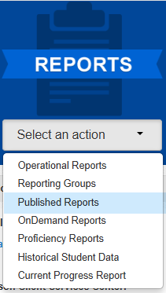
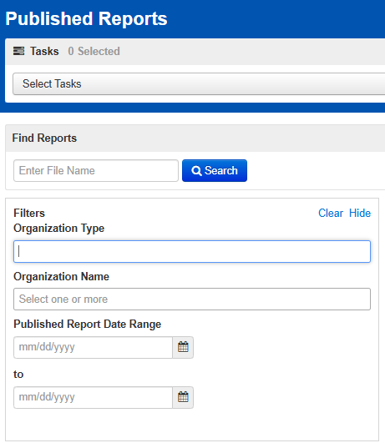
Downloading Summative reports in pearsonaccess next
Reports > Published Reports
Notes:
From the PearsonAccess^{next} homepage, select “Published Reports” from the Reports menu.
On the Published Reports page, you may use the filters on the left side of the screen to narrow down your results.
The Organization Type filter may be used to filter district level or school level reports only for district level users.
The Organization Name filter may be used to filter for a specific school.

Slide 18
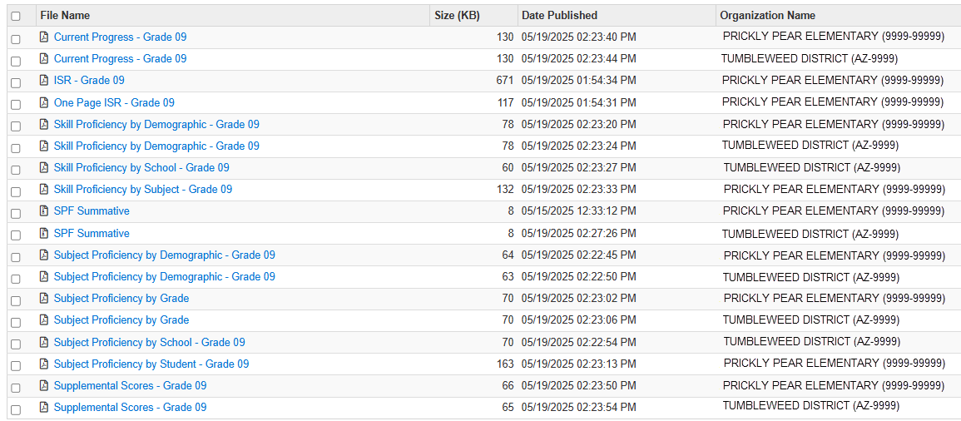
Downloading Summative reports in pearsonaccess next
Reports > Published Reports
Notes:
To view and download a Summative Report or the Student Performance File, click on the desired file name hyperlink. Save the file according to the process for your browser.

Slide 19
ACT® Aspire® OnDemand Reports
Notes:
ACT Aspire OnDemand Reports are available in PearsonAccess^{next}.

Slide 20
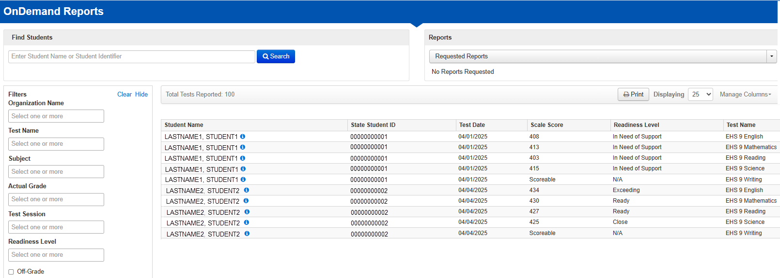
Ondemand reports in pearsonaccess next
Reports > OnDemand Reports
Notes:
OnDemand Reports are available to view and print in PearsonAccess^{next}. Go to Reports > OnDemand Reports.
Full access to OnDemand Reports is granted to the Administration Test Coordinator and Test Coordinator. Full Access Educator and Reports Only Educator roles may be granted access to students assigned to them in Reporting Groups in PearsonAccess^{next}.
Reports can display by Reporting Groups if these were set up by the school during the specified time frame. Filter and sort options are available for use in the OnDemand Reports.

Slide 21
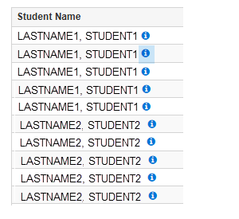
Ondemand reports in pearsonaccess next
Reports > OnDemand Reports
Notes:
The default view of OnDemand Reports is a roster showing all students the user has permission to view. For detailed results, users can click on the information icon next to the student’s name.

Slide 22
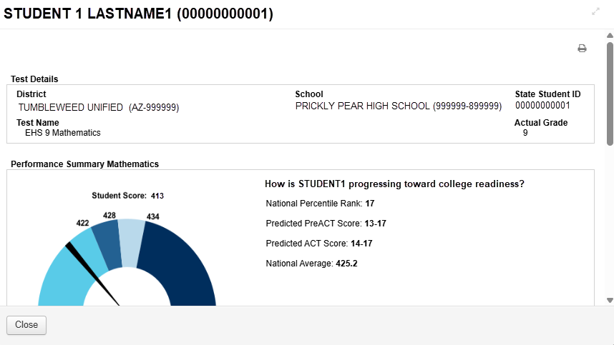
Ondemand reports in pearsonaccess next
Reports > OnDemand Reports
Notes:
OnDemand Reports’ student detailed reports are available by subject and include National Percentile Rank, Predicted PreACT Score, Predicted ACT Score, and National Average.

Slide 23
ACT® Aspire® Summative Report Resources
Notes:
Now we will discuss resources available for ACT Aspire Summative Reports.

Slide 24
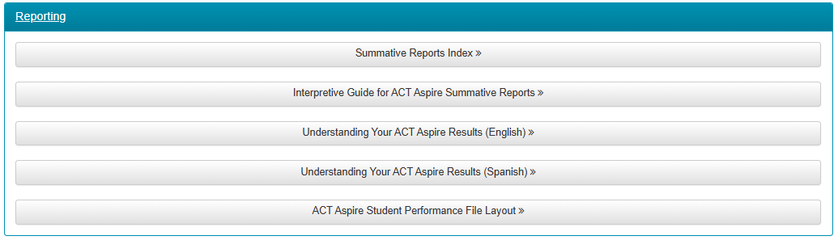
Resources
Web pages and Resources
Arizona ACT Aspire Support Page
https://az-support.mypearsonsupport.com/aspire/
Notes:
The Arizona ACT Aspire Support Page contains useful resources with detailed information about the Summative Reports. We suggest bookmarking the Arizona ACT Aspire Support Page for future reference.

Slide 25

Questions? We’re here to help!
Pearson Customer Support:
Phone: 1.888.705.9421 Option 4 (ACT Aspire)
Hours available: Monday-Friday 7:00 am - 7:00 pm (CST)
Notes:
This concludes the ACT Aspire Summative Reports training. If you have any questions, please contact us at the number provided on this slide.

